Slide 1
Organizational Health - A New Methodology & Survey for Measuring

Slide 2
Organization Health Research Overview
Objective Statement:
This study examines ‘organizational health’, what it consists of, how it is measured, and keys to improvement.
Undergraduate Researchers: Elizabeth Rosene (2 semesters), Benjamin Hall (1 semester)
Research Partners: Professor Ray Mentzer, Marsh, American Chemistry Council (ACC)
2nd Semester undergraduate research project
Draws upon work from
McKinsey & Company
BST
CCPS
Notes:
Much has been written about the importance of a company’s ‘safety culture’ in strong process safety performance. This study builds on that and examines ‘organizational health’, what it consists of, how it is measured, and keys to improvement.

Slide 3
Safety Culture vs. Organizational Health
Safety Culture
Organizational Health
Composed of organizational culture and capability
Organization’s ability to align around a common vision, execute that vision, and renew itself through innovation
Important to company’s sustainability
Capacity to learn and motivation to make continuous change
Achieve & maintain high performance
Shared beliefs, practices, & attitudes toward safety
Through design or default
Shaped by leadership with clear expectations
Leaders & employees show caring for each other: stories, observations, and conversations
Notes:
Organizational culture is defined as the extent in which a company supports their safety culture through reliable operations, internal and external engagement by all levels of the business, and the ongoing support of each employee’s safety.
Organizational aptitude is defined as a company’s ability to utilize its specific tool set of knowledge, experience, data, and analytic tools to build a strong backbone and support process safety throughout the organization.

Slide 4
Development of Research & Tools
Void in area of organizational health (OH)
No metric available for measuring current OH or providing guidance to improve
High performance in OH difficult to achieve without commitment & resources
Prior development of OH tools from
McKinsey & Company: Definition of & Key Organizational Outcomes
BST: Idea of Organization Culture and Organization Capability
CCPS: Core Principles to Drive Performance Improvement
Notes:
McKinsey & Company: 9 Organizational Outcomes
Direction
Shared Vision
Strategic Clarity
Employee Involvement
Innovation and Learning
Top-down innovation
Bottom-up innovation
Knowledge sharing
Leadership
Authoritative Leadership
Consultative Leadership
Supportive Leadership
Challenging Leadership
Coordination and Control
People performance review
Operational management
Financial management
Professional standards
Risk management
Capabilities
Talent acquisition
Talent development
Process-based capabilities
Outsourced expertise
Motivation
Meaningful values
Inspirational leaders
Career opportunities
Financial incentives
Rewards and recognition
Work Environment
Open and trusting
Internally competitive
Operationally disciplined
Creative and entrepreneurial
Accountability
Role clarity
Performance contracts
Consequence management
Personal ownership
External orientation
Capturing external ideas
Customer focus
Competitive insights
Business partnerships
Government / Community relations

Slide 5
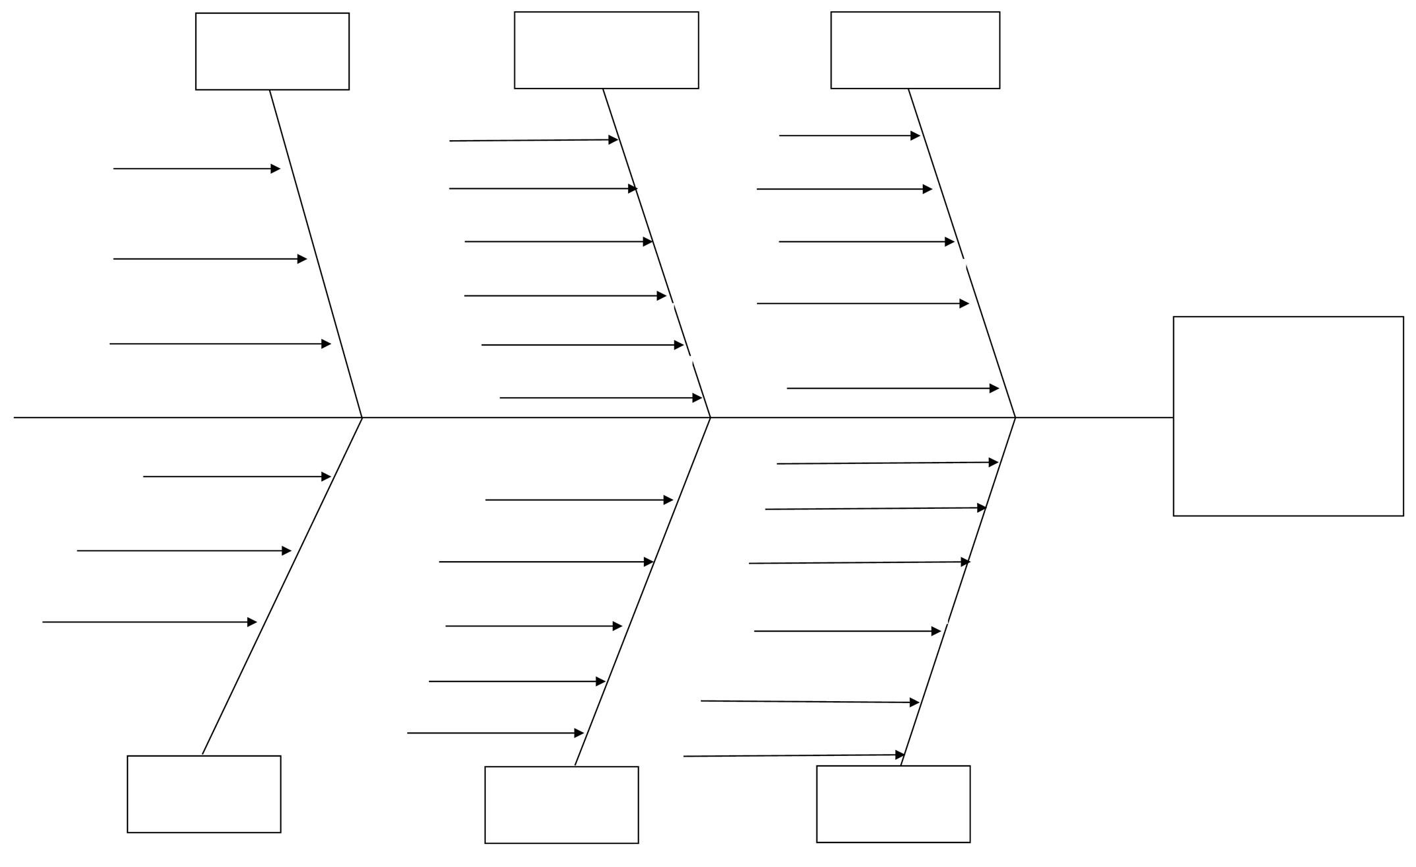
Development of Research & Tools
OH metric fishbone model developed
Provides visual representation of key factors of OH
Fishbone design allows for proper division of OH elements (aptitude & culture), and providing grouping of associated metric elements while also showcasing key factors
OH metric support tables
Provides additional guidance to further analyze and improve upon OH
Pulls tangible standards, programs, etc. to create an interactive and in-depth resource for one time or periodic company use

Slide 6
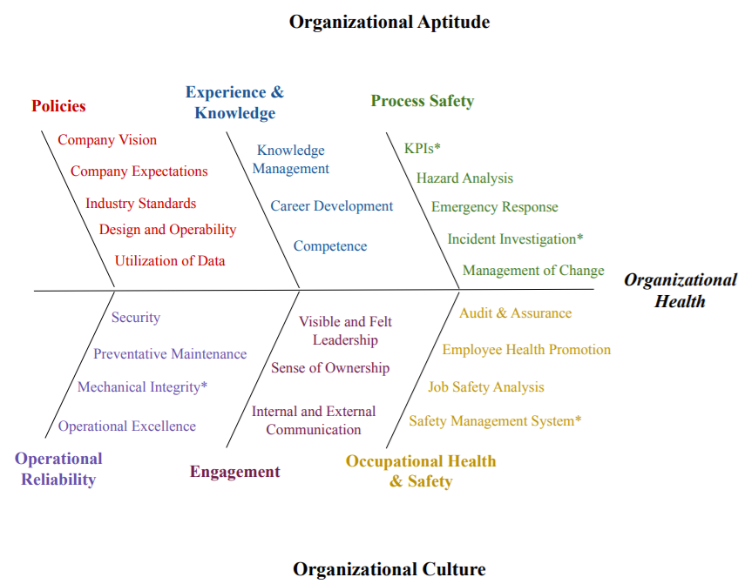
Organizational Health Fishbone
Notes:
Explain layout of fishbone – aptitude and culture
Explain the main elements of each (Have definitions prepared in case detailed questions asked)
Explain the sub-elements below each main bone

Slide 7
Process Safety, Occupational Health & Safety Elements Further Explained
Process Safety
KPIs*
Hazard Analysis
Emergency Response
Incident Investigation*
Management of Change
Occupational Health & Safety
Audit & Assurance
Employee Health Promotion
Job Safety Analysis
Safety Management System*
Notes:
Explain in detail each element and use of asterisks

Slide 8
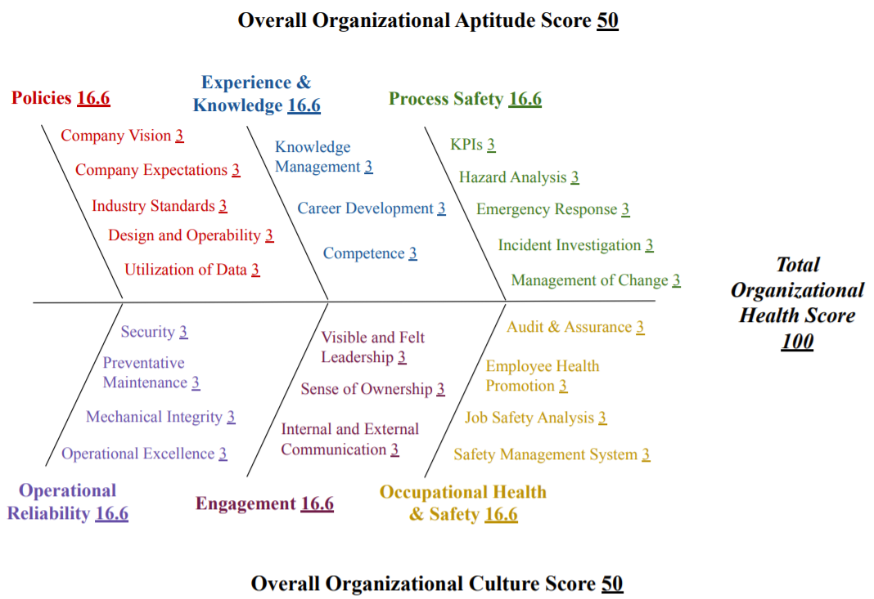
Organizational Health Fishbone Scoring
Notes:
Discuss mentality behind scoring

Slide 9
Organizational Health Fishbone Survey
https://www.surveymonkey.com/r/VSRYTCY
Notes:
Explain online survey created

Slide 10
Organizational Health Fishbone Survey: Preview
Notes:
Explain major bones and elements
Surveys

Slide 11
Organizational Health Support Tables
Metric to evaluate factors contributing to the six key fishbone elements of Organizational Health
Include standards, methods, programs, information, etc. to improve upon or properly maintain any organizational health element
Tables divided into
“Essentials” or “must haves” (blue color)
“Excellence” or “must wins” (amber color)

Slide 12
Organizational Health Support Tables

Slide 13
Organizational Health Support Tables

Slide 14
Organizational Health Support Tables

Slide 15
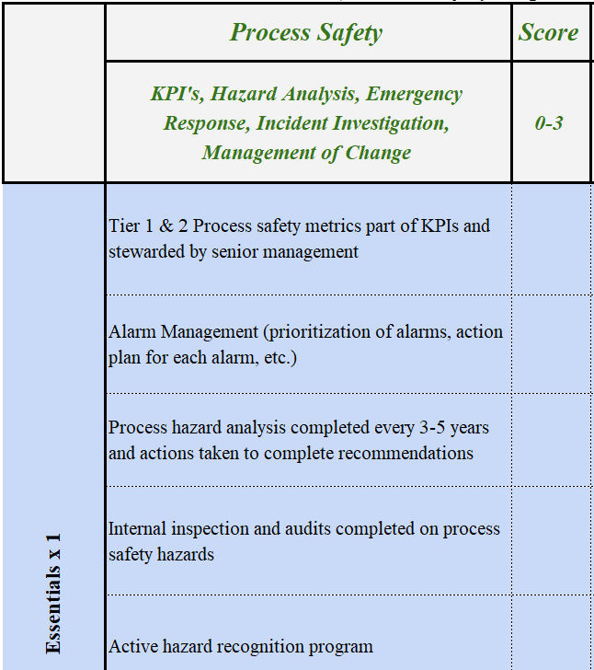
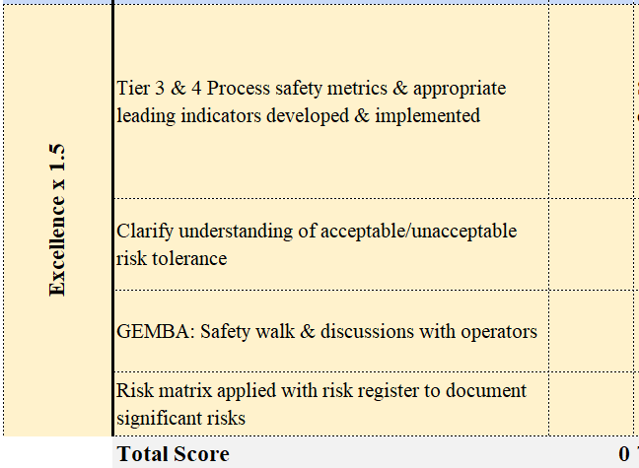
Process Safety Metric Expanded
Notes:
Explain in detail each element and use of asterisks

Slide 16
Company Involvement
Three industry partners in 2021 semester
Those in organization who might complete survey
Process Safety Lead
Safety Lead
Operations Manager
HR Manager
Role of Company in Purdue Research
Review and comment on OH material
Missing metrics of fishbone, support tables
Suggest improvements on fishbone, support tables
Comment on future application of OH metric tools
Unit Superintendents
Maintenance Manager
Engineering Manager
Notes:
The fishbone model survey and metric support tables were quality tested by multiple industry partners. Company A, B, and C were asked to complete both the fishbone survey and metric support tables and provide thorough feedback on ease of use, opportunities for improvement on the quality of each element / metric, and suggestions for any missing or lacking elements / metrics. The feedback received from these completed “road-tests” was immediately applied to the existing models. The interaction between the research team and Company A, B, and C allowed for the quality and applicability of the organizational health models and scoring metrics to significantly improve while providing the industry partners with a new opportunity to improve upon and bring awareness to the organizational aptitude and culture of their company.

Slide 17
Conclusions & Recommendations
OH Fishbone Metric and Metric Support Tables provide opportunity to increase performance & continuously improve each element of organizational health through tangible scoring metrics
If elements of fishbone and metric support tables are assessed, reviewed, enforced, and audited then a safer and healthier work environment can result
Looking for Additional Industry Partners to Pilot Organization Health Metrics
Contact Information
Elizabeth Rosene: erosene@purdue.edu
Professor Ray Mentzer: rmentzer@purdue.edu

Slide 18
Questions?

